Slide 1
Towards The Systematic Design of Model Animation:
Key Ingredients and General Guidelines
Moussa Amrani, Abdelkader Ouared,
Pierre-Yves Schobbens
Modeling Language Engineering (Mle) Workshop
Co-Located with MoDELS 2022
Monday 24th October, Montréal, Canada

Slide 2
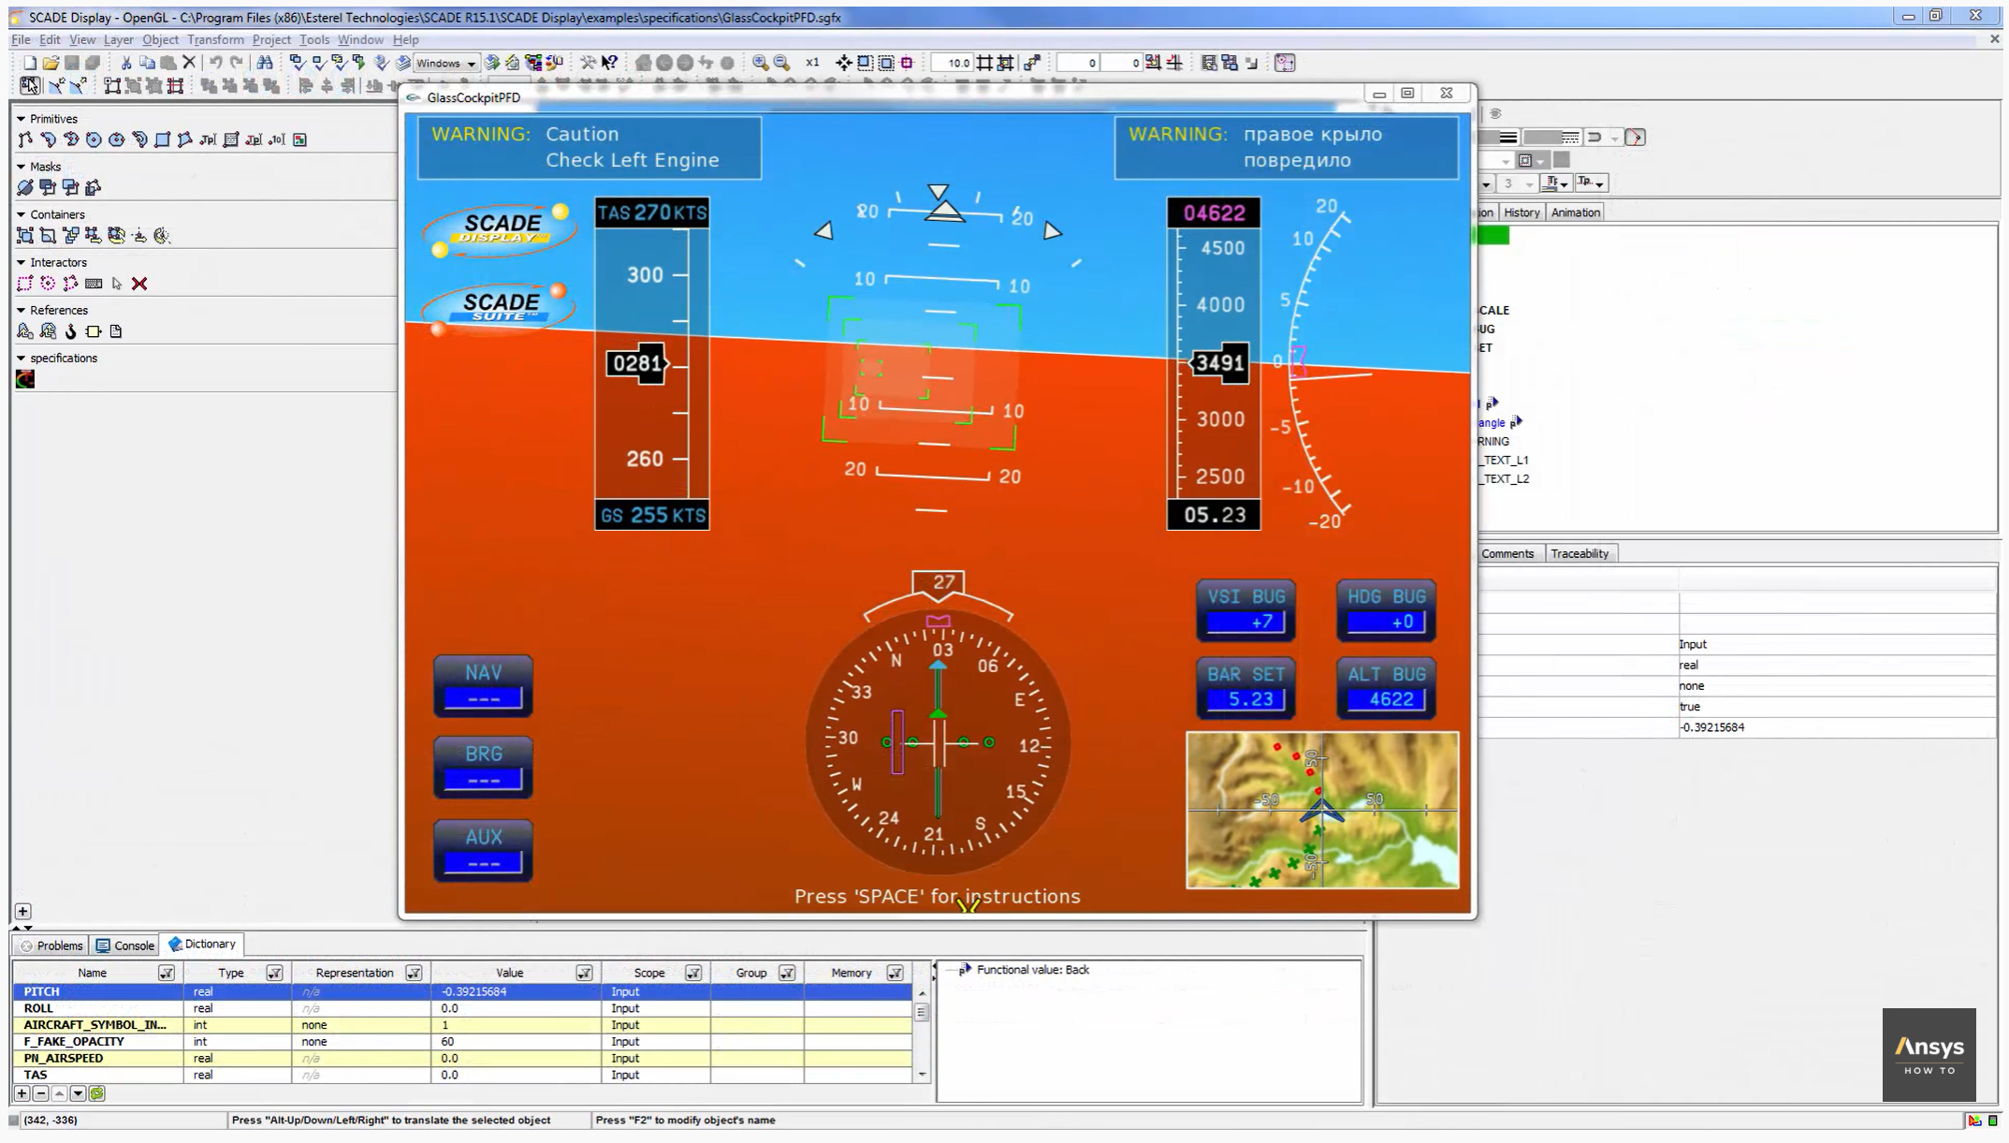
MA Example
Simulation of a SCADE Display Model **
**https://www.youtube.com/watch?v=kaJfTS2WvEA

Slide 3
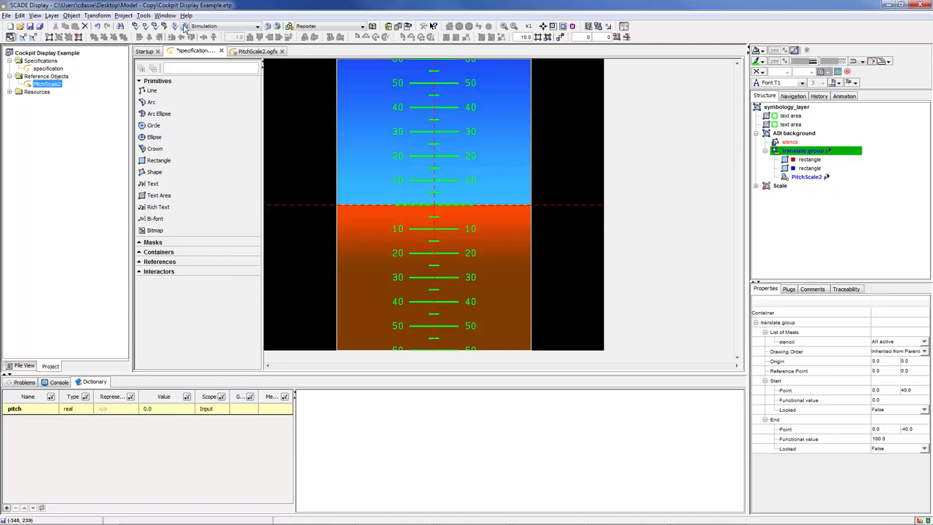
MA Example
Simulation of a SCADE Display Model **
Design Embedded Displays for HMIs
**https://www.youtube.com/watch?v=kaJfTS2WvEA

Slide 4



Roles in MDE
1
Metamodel Level
Domain-Specific Metamodeling Language
Transformation Language
Language
Designer
Conforms to
Conforms to
2
3
Model
Level
Model Definition
Transformation Specification
Modeller
Transformation Expert
Knows
Application
User
MA Designer (new Job)

Slide 5
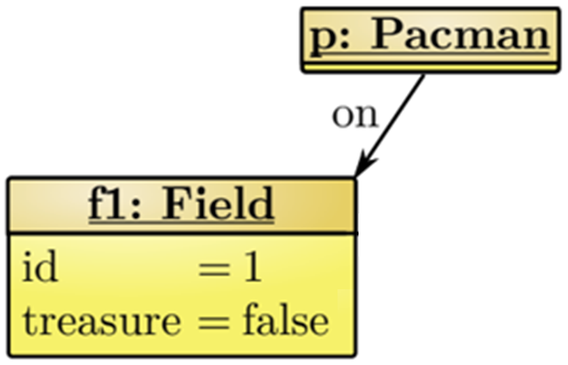


What is a Model Animation ?
Visualization
Map elements: MM, CS
Simulation
DSL's behavior as MT
Animation
Model Animation (MA)
MA can be seen as the visual representation of the simulation of Model Transformations (MTs)
MovePacman
1
right
2
1
right
2
in
in
CS
Rendering
MM
Parsing
Simulation
M_{CS}
M
Animation
Simulation
[Levi Lúcio and al. 14]

Slide 6
MA in a nutshell
Transformation chain coupling within Animation
Operation 1
Operation 2
Multitask A
Operation 3
Animation 1
Animation A.3
Animation 3.1
Animation 3.1
M_{in}
M_{io}
dependency
Animation A.1
Animation A.2
Animation A.4
Notes:
What are Min and Mio?
The approach is guided BY TRAFOS: one TU triggers one or several UA, not the other way around
The figure is overcomplicated.
Put four TU steps
The first corresponds to one AU step
The second and fourth correspond to 3 steps
The third correspond to 5

Slide 7
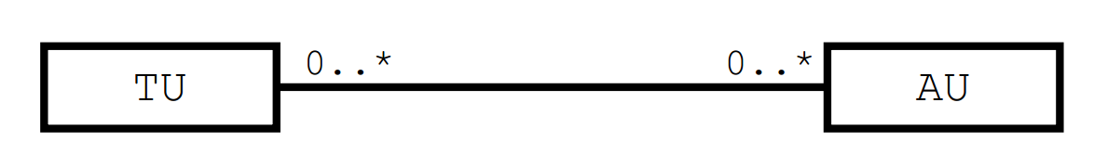
Decoupling TUs and AUs
Lack ﬂexibility in the MA specification, and reuse of MA units
Animation
Engine
Fully unlock the potential of MA engineering
N:N Mapping: Transformation (TU) and Animation (AU) Units
Notes:
Remove the image and the “fully unlock…”
EXPLAIN how reuse can be achieved:
1 TU corresponds to several AUs (previous slide)
1 AU may be used for several TUs

Slide 8
Challenges
3 Key Challenges to adress:
Explicitly define CS for easily expressing MA;
Build an MA language to express AU in a compositional way,
Explicitly relate MA units with their transformation counterparts
Notes:
Change the title to “3 Key Challenges” and just number them

Slide 9
Concrete Syntax
Notes:
CONCRETE !!!!

Slide 10
Complex Rendering Patterns
Visual Representation
Define the rendering relationship
e.g. FSM DSL (Finite-State Machines)
State Transition
FSM
1 fsm
FSM
1 fsm
FSM
1 fsm
...
...
...
1..*
states
1..*
states
1..*
states
Final
State
« enumeration »
Kind
State
State
1 initial
...
INITIAL
REGULAR
FINAL
kind: Kind
...
Initial
1 final
Regular
Evaluate Ref.
Check Enumeration
Map. Class
▶ Providing complex rendering patterns
Notes:
Put the symbol for INITIAL and FINAL states, and write the queries explicitly in each metamodel, with a table for each State kind

Slide 11
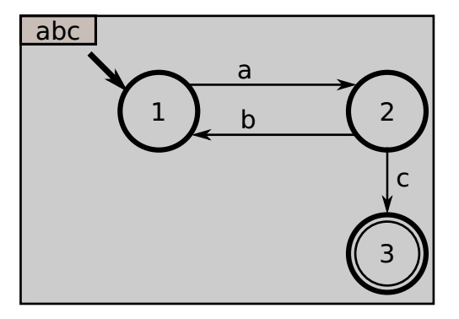
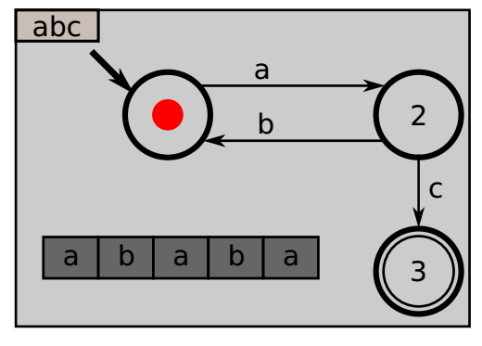
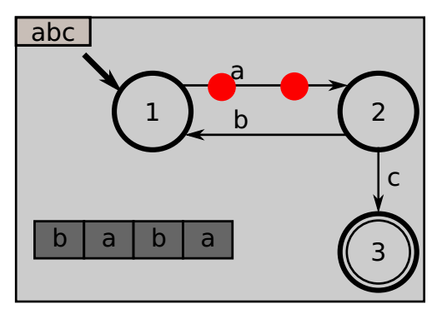
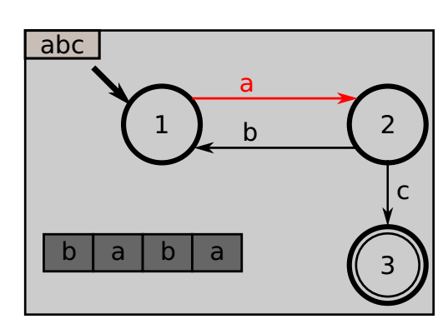
Providing “snapping” capabilities
Alternative representation of MA
e.g. Two categories of Animations
Showing the progression on the word
Showing the FSM’s current state
Variability model animation specification
Sequential
Concurrent
Timed approach
Providing “snapping” capabilities
Notes:
This is not SNAPPING… To be discussed

Slide 12

Integrating “insideness” natively
Example of simultaneous image contrast illusion
e.g. PacMan kills Ghost
Parallel:
① Appear(Pacman)
② Desapear(Ghost)
Sequential:
③ Desapear(Pacman)
④ Appear(Pacman)
Game Illusionization
Create/detele
Visual
Eﬀects
Sequences
of images chained
Illusion Animation
obtained
Notes:
Remove Illusionization: it is a very specific term, used in one paper that you read but not the audience, and that does not bring anything.
Similar to previous, this is not what is intended with “insideness”…

Slide 13
Supporting animations natively
Fast Update of Visual Features
Browsing, customize/extend/modify
e.g., the position, size, color
Conjoined/Nested Element Block
Usability Mechanisms
Using the Graphical Elements
Using Visual Language
e.g. Block Oriented Modeling, Causal Modeling
Visual editor workspace
Visual Features
- Position
- size
- color, ..
Graphical Elements
MA Designer
Edit Element
Notes:
I don’t get the figure
I don’t get the examples under “Using Visual Languages”

Slide 14
MA Specification

Slide 15
MA Effects vs. Schedule
Design the MA framework: De-/Reconstruction of MTLs [ Syriani and al. 14]
→ Separating Effects from scheduling
MA Framework
A primitive Combinators
separate
an elements
UA Eﬀects Library
Creation Eﬀects
Basic animation eﬀects
WorkSpace
WorkSpace
Deletion Eﬀects
CTRL 1: Loop
shape
CS components Library
Action Eﬀects
Sequantial
Table
CTRL2: time
Parallel
table
Graphical
Elements
Path Motion
TexBox
combinators outside
Organized and scheduled
C k
Geometric
Combinators m
Element n
delay
Repetitors
//
Embedding
the scheduling inside
the UAs
Complex Animations
Notes:
Similar to Syriani et al., 2014, we separate
Animation Effects, from
Animation Scheduling
You can orally comment the similarity (Trafo blocks + Scheduling)
The figure does not bring much, and is difficult to read, and requires you to explain it during a long time

Slide 16
UA Effects
Creation effects
e.g. by simply making it appear at a position, or by “zooming” it in,
Deletion effects
e.g. by making it disappear, or by “zooming” it out.
Action effects
e.g. the color, size, etc. of a text, a shape or a connector.
Path Motion effects
e.g. a straight or curved line
Notes:
Illustrate with simple things, typically on the FSM DSL

Slide 17
UA Scheduling
Theoretical Approaches for UA Scheduling
Embedding the scheduling inside the UAs
Define combinators outside of UAs
A11
A12
A13
B1
B2
||
;
;
B1
B2
A11
;
A12
A13
Notes:
EXAMPLE!!!

Slide 18
Relating
How to relate to the DSL at hand ?
How to synch TU and AU ?

Slide 19
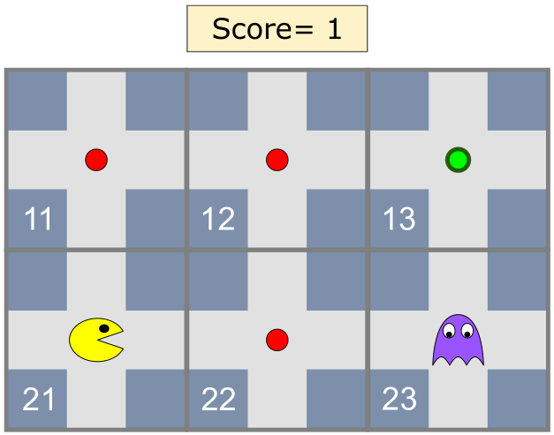
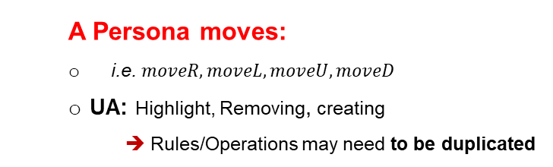
UA Parameterization
A Persona moves:
i.e. $moveR, moveL, moveU, moveD$
UA: Highlight, Removing, creating
➔ Rules/Operations may need to be duplicated
Transferring tokens :
frying tokens between two places
UA: Highlight, Removing, creating
Fully animate the DSL behavior: Disappears, Reappears

Slide 20
UA Parametrizaion
Possible Param. Values
Possible Param. Values
Parameterisation of Animation
Browsing, customize/extend/modify
Conjoined/Nested Element Block
Mechanism required
Using Model’s Elements
Using the Graphical Elements
Two basic animation units
APP: making an element appear
DAPP: making an element disappear
Complex Unit BLINK = APP ⨁ DAPP
P1 …Pm
P1 …Pm
Define
Composer
UA1
paramter=values
UA2
Attche
what
what
on
on
BLINK
DAPP
;
APP
what
on
period = period
what
from
what
where
period
Notes:
Too much things are mixed in this slide…
This should focus on parameters:
Why do we need parameters (typically, illustrate the previous one)?
What problems does it bring to introduce parameters?

Slide 21
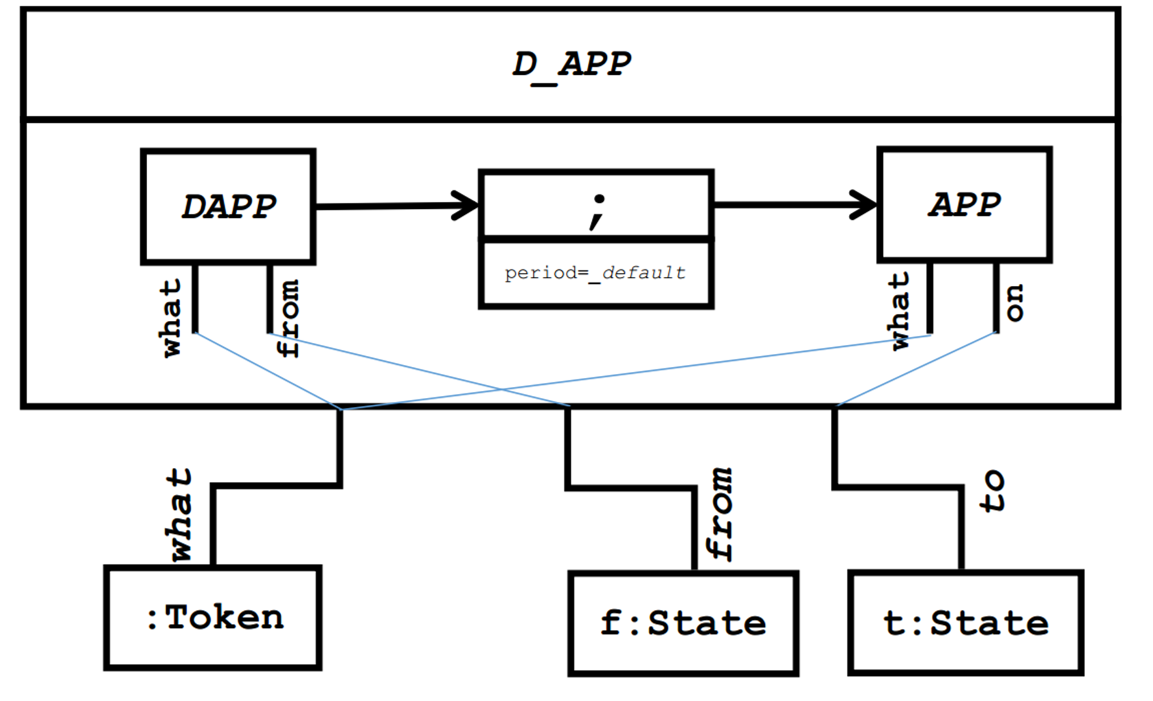
UA Parametrizaion
Reuse
:Pacman
f: Cell
t: Cell
Notes:
SECOND STEP: To what do we connect parameters
Model Elements (left)
CS Elements (right)
But they are similar up to the rendering trafo, assuming this is easy to compute on each step (or, to cache for the current model)

Slide 22

TU/TA Linking
?
How are mapped AUs to specific TUs ?
By Annotation:
Annotating TUs, i.e. @Step annotation
Annotating AUs with TUs $ref
∼ map TUs with debugging [Erwan B., et al. 2018]
By Explicit Map:
Defined outside both the MT and MA Specifications
Transformation Specification
class PacMan { ... @Step def boolean moveR() { if(self.in.right != null){ self.in = self.in. Right}
Notes:
Remove the TU ---- AU figure: this is not its point
Illustrate the idea…
We want to be able to notify the MA engine that a TU is currently executed, so the the MA engine performs the animation.
Two problems here:
How do we locate relevant TUs inside the overall transformation?
What is the communication process between both engines?
Solution: the GeMoC approach for debugging, with
Annotations for TU
Comm protocol based on four notifications (cf. paper… but put them in the slide!)s

Slide 23
Conclusion
Model Animation of Model Transformation in MDE
Lack ﬂexibility in the MA specification, and reuse of MA units across DSLs
First step towards a systematic approach for MA engineering,
Three important challenges.
Designing concrete syntaxes for DSLs,
A compositional approach for defining complex MA,
Linked to appropriate TUs that would drive the MAs.
Future work
Engineering our Proposal
Evaluating the Prototype's Usability
Be Used as an Educational -Aid Tool
Notes:
This should be rewritten completely

Slide 24
Thank you for your attention

